Slide 1

HOSPITAL TREATMENT PACKAGE PRICING

Slide 2

OBJECTIVE
To develop an algorithmic framework leveraging patient data analytics and healthcare cost-effectiveness analysis to optimize treatment packages. The aim is to create personalized, efficient, and cost-effective treatment plans that maximize patient outcomes while minimizing expenses, ensuring better allocation of resources and improved healthcare delivery.

Slide 3
INTRODUCTION
Hospital treatment package pricing involves customizing and refining treatment plans to improve patient care while managing costs and resources effectively. This approach uses data analysis, personalized care strategies, and evidence-based practices to create tailored treatment pathways.
Improved Patient Outcomes
Cost Management
Resource Efficiency
Personalized Care
Enhanced Healthcare Delivery
Data-Driven Decision Making

Slide 4
Data Visualization

Slide 5
WHY DATA VISUALIZATION ?
1)Simplifies complex data for easier comprehension.
2)Unearths insights and aids in informed decision-making.
3)Facilitates effective communication to diverse audiences.
4)Enhances pattern and trend recognition in data.
5)Identifies anomalies or outliers for error detection.

Slide 6
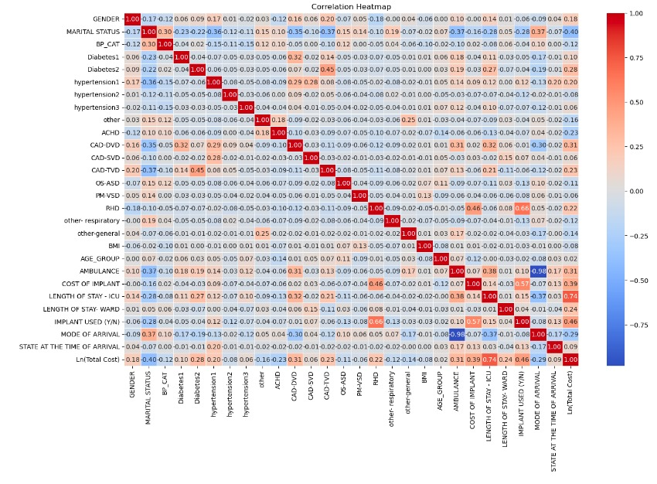

Slide 7
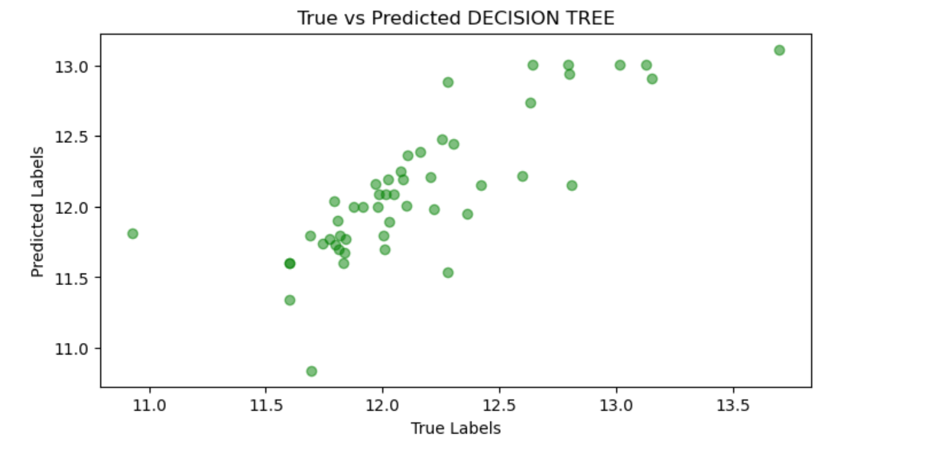
DECISION TREE

Slide 8
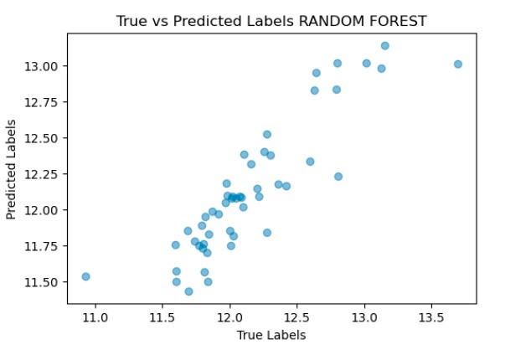
RANDOM FOREST

Slide 9
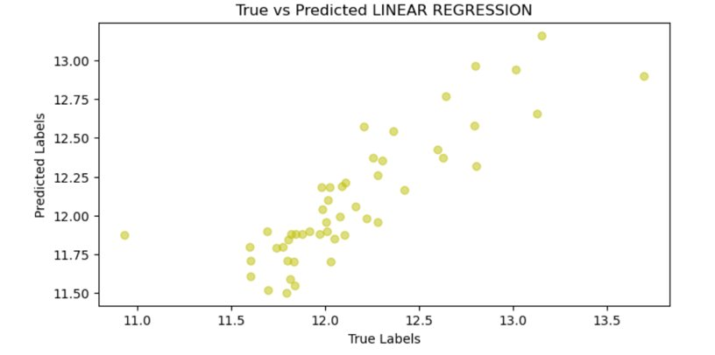
LINEAR REGRESSION

Slide 10
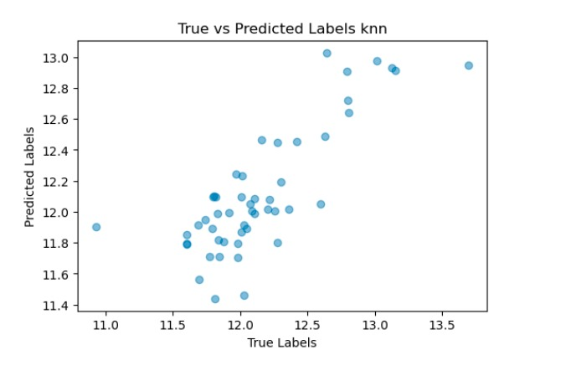
K-Nearest Neighbors

Slide 11
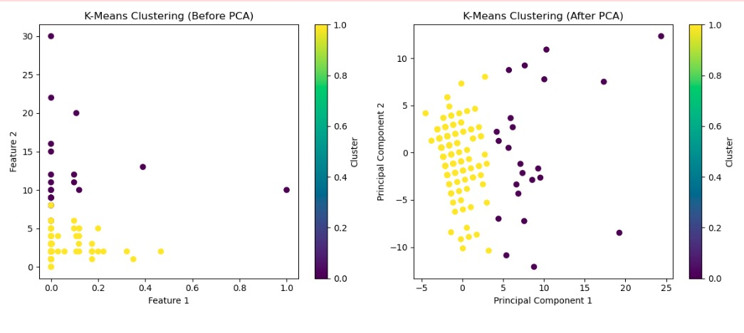
K-Means Clustering

Slide 12
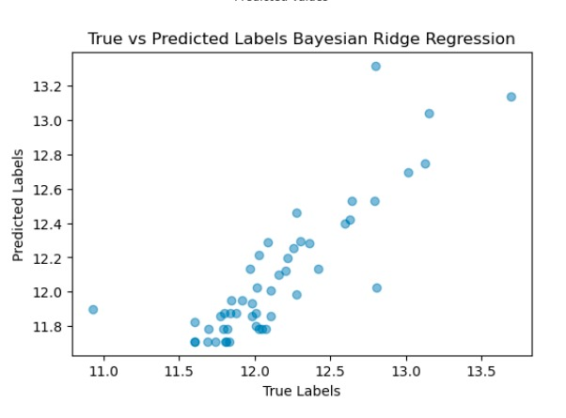
Bayesian Ridge Regression

Slide 13
RANDOM FOREST
Data Collection: Gather features and corresponding labels. Preprocessing: Clean data, handle missing values/outliers, encode categorical variables, and split data into training/testing sets.
Model Selection: Choose Random Forest for versatile classification/regression tasks, reducing overfitting by combining decision trees.
Hyperparameter Tuning: Optimize performance by adjusting tree count, depth, and split criteria using techniques like cross-validation. Model Training: Train Random Forest with chosen parameters to learn relationships between
features and labels. Feature Importance: Assess feature significance using built-in tools, visualize importance scores for insights into predictive power.
Model Evaluation: Assess model performance using metrics like accuracy, precision, recall, F1-score, and ROC curve on the test set. Fine-tuning: Refine the model iteratively through parameter adjustments or feature engineering to enhance accuracy.

Slide 14
JUSTIFICATION
RANDOM FOREST: In our healthcare pricing optimization project, the Random Forest model proves its mettle by accurately forecasting treatment package costs. Its ensemble methodology ensures robust predictions, balancing precision and generalizability—a pivotal factor in establishing fair and competitive healthcare pricing strategies.
BAYESIAN RIDGE REGRESSION: Bayesian Ridge Regression is a powerful regression technique that combines the principles of Bayesian statistics with linear regression. Its strength lies in its ability to handle multicollinearity and prevent overfitting by introducing regularization through prior distributions.Its adaptability to different data distributions and robustness in handling noisy data make it a suitable choice for regression tasks in various domains.
KMEANS CLUSTERING: K-means Clustering: K-means clustering is a powerful unsupervised learning algorithm widely used for clustering tasks. Its strength lies in its ability to partition data into K clusters based on similarity, making it effective in various domains. Its simplicity and scalability make it a versatile choice across different industries and applications.

Slide 15
KNN
R2 Score : 64.87%
MAE : 21.93%
MSE : 81.23%
EV Score: 65.15%
K Means
Silhouette Score : 60.19%
Random Forest
R2 Score : 78.16%
MAE : 16.62%
MSE : 50.40%
EV Score: 78.41%
Bayesian Ridge
R2 Score : 70.93%
MAE : 17.82%
MSE : 67.24%
EV Score: 72.13%
Linear Regression
R-squared : 70.34%
MAE : 18.19%
MSE : 68.58%
EV Score: 71.87%
PRECISION GLOBES

Slide 16
More about Random Forest...
1. Effective in high-dimensional spaces.
2. Robust to overfitting, especially in high dimensions.
3. Versatile for both classification and regression tasks.
4. Handles non-linear relationships without feature transformation.
5. Ensemble approach aims for optimal collective solution.
6. Reasonable performance with small sample sizes.
7. Robustness to outliers due to ensemble nature.
8. Memory-efficient by focusing on important features.
9. Rooted in decision tree principles for mathematical foundation.
10. Built-in regularization through bagging and random feature selection.

Slide 17
CONCLUSION
The utilization of a Random Forest machine learning model in healthcare for predicting and optimizing hospital treatment package prices has emerged as a pivotal step towards addressing pricing discrepancies. By leveraging diverse factors like hospital infrastructure, location, patient demographics, and treatment specifics, this model offers a pathway to greater transparency and fairness in healthcare costs. Its capacity to navigate complex datasets and discern intricate relationships among variables provides healthcare providers with a tool to determine competitive yet equitable pricing strategies. However, continual updates and collaboration among stakeholders remain crucial to ensure its accuracy and relevance in evolving healthcare landscapes. Overall, the Random Forest model signifies a substantial stride towards fostering consistency and fairness in healthcare pricing, fostering patient trust and improving access to quality care.

